Slide 1

ETHICAL GUIDELINES FOR RESEARCH INVOLVING THE SÁMI PEOPLE IN FINLAND
SÁMIIDE GUOSKI DUTKAMA EHTALAŠ RÁVVAGAT SUOMAS
SÄMMILIJD KYESKEE TUTKÂMEETTISIIH RAVVUUH SUOMÂST
SÄʹMMLAID KUÕSKKI TUʹTǨǨUMMUŽ EETTLA VUÄʹPPÕÕZZ LÄÄʹDDJÂNNMEST
SAAMELAISIA KOSKEVAN TUTKIMUKSEN EETTISET OHJEET SUOMESSA
Link: https://urn.fi/URN:NBN:fi:oulu-202405294076
https://oulurepo.oulu.fi/handle/10024/50115
Published 2024

Slide 2
Working group
Lydia Heikkilä, Sámediggi
Rauna Kuokkanen, University of Lapland
Veli-Pekka Lehtola (2018-2023), University of Oulu
Päivi Magga (2018–2020), Siida, Sámi Museum
Sigga-Marja Magga, University of Oulu
Janne Näkkäläjärvi, Sámi Education Institute SOGSAKK
Sanna Valkonen (2018–2023), University of Lapland
Pirjo Kristiina Virtanen, Helsinki University
Advisory board 16 members, negotiations with TENK
Continuing dialogue with Sámi society: Numerous hearings with Sámi communites, webropol questionnaire, Sámi Parliament
Consensus princinple
https://www.ulapland.fi/FI/Kotisivut/Saamelaisia-koskevan-tutkimuksen-eettiset-ohjeet-

Slide 3
Starting point and need
Shared sovereignty:
  Sámi right to self-determination as an Indigenous people (Pl 17.3§) and
  Freedom of science guaranteed by the Constitution (Pl 16§)
Historical and present-day disproportionate power structures, that affect the implementation and settings of research

Slide 4
Objectives and application
Building an ethically better informed dialogue between the scientific community and the Sámi society
Quality of research
Creating culturally safe research conditions and implementation of research
  oadjebasvuohta (Northern Sámi), torvolâšvuotâ (Inari Saami) and staanvuõtt (Skolt Saami)
Living document; to be updated according to the changing situation and needs

Slide 5

4 Sámi values - Four G’s
Gulahallan / Addiittâllâm / Kulstõõllmõš
Reciprocal communication and engagement: a traditional Sámi way of interacting
Active listening, mutual understanding
Relationships based on trust
Aiming for oadjebasvuohta (cultural safety)

Slide 6

2.Guorahallan ja vihkkedallan / Kuorâttâllâm já viekkiistâllâm/ Tuʹmmstõõllmõš ja vieʹssõõllmõš
Assessment of the Benefits and Risks of Research and the Positionality of the Researcher
Locating the researcher's position and reflecting on the research tradition
Consideration from several perspectives: relevance, collective risks and harms
Reflecting on the research questions, theoretical framework and methods from the perspective of the Sámi people

Slide 7

3. Gudnejahttin ja árvvusatnin / Kunnijâttem já áárvustanneem / Ciistâst da äärvast âânnmõš
Appreciation of and Respect for Sámi Society and Knowledge
Respect for Sámi culture and society (recognition, practical applications)
Acknowledging and recognizing the Sámi languages, and Sámi knowledge, traditions and rights
Respect the Sámi land relations and social relations, including traditional governance institutions
Treating Sámi people as equal partners

Slide 8
4. Geatnegasvuohta dieđu máhcaheapmái ja juohkimii /
Kenigâsvuotâ macâttiđ já jyehiđ tiäđu /
Õõlǥtemvuõtt teâđ maacctummša da juâkkmõʹšše
Obligation to Return and Share the Information
  Responsibility and duty towards Sámi society and living environment
  Responsibility and obligation to share the research results with the Sámi community that participated in the research
  (communal ownership of data, access to, decision making of use)

Slide 9
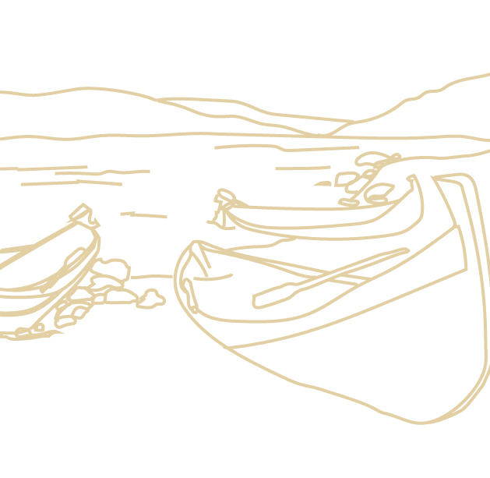
Main notes
Guidelines apply to all research that concerns the Sámi people, Sámi society and Sámi communities in Finland (Sápmi).
Including research conducted in Sámi Homeland.
Researchers’ self-regulation
Collective orientation in addition to individual
Diversity of the Sámi and Sámi society; traditional social and customary law-based systems still in form

Slide 10
´Natureculture´
  Indigenous views share holistic conceptions where nature and culture are inseparable
  According to the government's proposal (HE 309/1993 vp) of Finnish Constitution “the purpose of the fundamental rights provision is to secure the preservation of the entire original Sámi cultural form”.
  “The Sámi cultural form also includes their traditional livelihoods. It not only secures the maintenance and preservation of the language and culture, but also their development”.
  The Constitutional Law Committee stated that “Sámi culture also includes modern forms of application of traditional livelihoods” (PeVL 38/204 vp) (italics mine)

Slide 11
Particular concerns
Emphasized (self-)reflexivity and interactivity
The responsibility of researchers to familiarize themselves with Sámi culture and Sámi society well in advance and to clarify matters
Contacts, community consent, risks and benefits (collective perspective in addition to individual), cultural and linguistic capacities, relevant contents, research methods and means, collective rights of the research partners, including the storage and availability of research material
Strives to avoid unnecessary burden on the Sámi communities by familiarizing himself with previous studies on the subject
Extensive involvement >< load capacity of communities and individual groups

Slide 12
Particular concerns
FPIC: ”If the research is extensive or conducted with an identifiable Sámi community or in its area, the researcher/group is to request the community’s consent to their reserach.”
Sámi Parliament in Finland and Skolt Sámi Assembly have procedures for seeking communal consent.
Sámi collective cultural heritage and traditional knowledge:
  Sámi cultural norms regarding collection and sharing of knowledge.
The intellectual property rights of the Sámi:
Traditional knowledge and cultural heritage that is collectively produced and shared (incl. hunting, fishing, gathering and reindeer grazing; sacred places and the related knowledge)
>UN: Declar. of Indigenous Peoples’ Rights 2017, CBD 1992, Art. 8 (j); Akwe:Kon Guidelines 2004, Tkharihwaie:ri Code of Conduct 2011

Slide 13



